Slide 1
Where can I hide?
An analysis of invisibility in a smooth scene
John K. Johnstone
Dept. of CS, IUPUI
March 12, 2004

Slide 2
Invisibility
Perseus, the Nymphs, and the helmet of invisibility in the Greek legend of Medusa
Harry Potter’s invisibility cloak
we want to analyze where an object effectively becomes invisible

Slide 3
Introduction
consider a scene of objects and a distinguished object L in this scene
we want to compute the region of space from which L is invisible
occlusion culling
  reveals camera locations from which L need not be rendered
shadow
  computes the umbra cast by L (if L is a light)
camera placement
  reveals camera locations that avoid seeing L
motion planning
  may be used to plan motions through the scene that remain hidden from L

Slide 4
Novel issues
smooth scene
  smooth, arbitrary freeform objects
  not polygons and polyhedra
inherently parallelizable: one object dominates at a time

Slide 5
Related work
huge literature on visibility analysis [Durand 99]
  mostly for polyhedral meshes
aspect graph [Gigus and Malik ’90, Petitjean ’92, Eggert ’93, …]
discontinuity mesh (e.g., Heckbert ’92, Drettakis and Fiume ’94)
visibility skeleton and visibility complex [Pocchiola and Vegter ’96, Durand ’97]
recently, much work on pushing visibility analysis, especially shadow computation, to interactive speeds on polygon meshes
  SIGGRAPH 2003 alone: Assarsson ’03, Sen ’03, Govindaraju ’03
the lifting of these concepts to smooth scenes has been abstract (qualitative, topological)
hard and soft shadow computation
  mostly for polyhedral meshes
  shadow maps [Williams ’78, Sen ‘03] are designed for smooth objects
    but image space; prone to aliasing; point light
conservative visibility [Durand ’00, Leyvand ’03]
  don’t compute exactly

Slide 6
Structure of talk
introduction
visibility regions (local,global,back,front)
bitangents and visual events
local invisibility [local umbra]
global invisibility [global umbra]
sweeps to find global umbra
computing bitangents
incremental, independent computation
future work

Slide 7
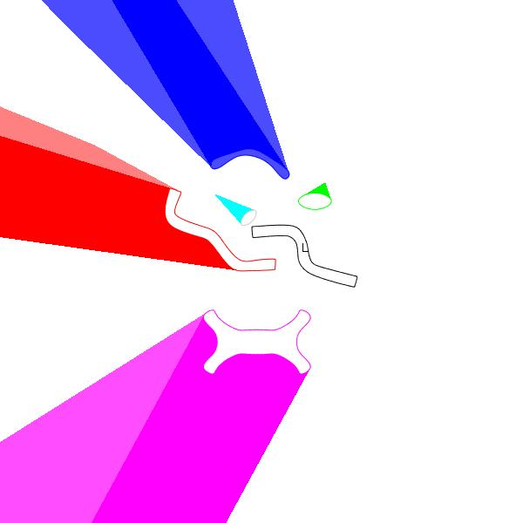
Shadows
if the distinguished object is interpreted as the light, invisibility from L = umbra
umbra of an object = region of invisibility defined by that object
partial visibility = penumbra
this terminology is borrowed from shadows
we will concentrate on the umbra, although this material generalizes to the penumbra

Slide 8
A divide and conquer strategy
to simplify the computation, we want to concentrate on one object at a time
how can this be done?
  visibility depends on interaction of many objects

Slide 9
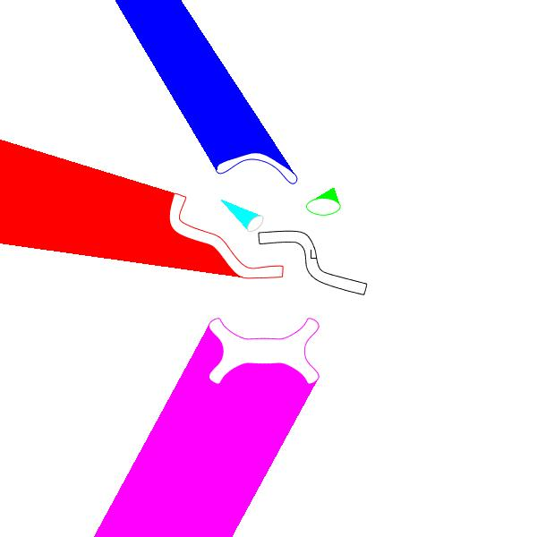
Local umbra

Slide 10
Global umbra

Slide 11
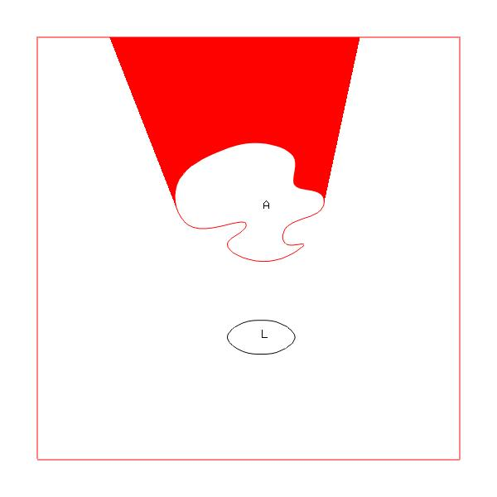

Front and back umbra
back umbra
  every object defines a back umbra
front umbra
  some objects cast ‘shadow’ on themselves

Slide 12
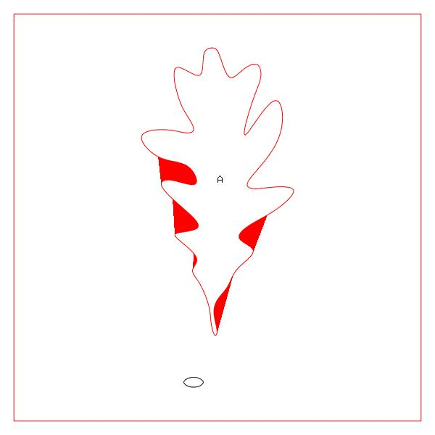
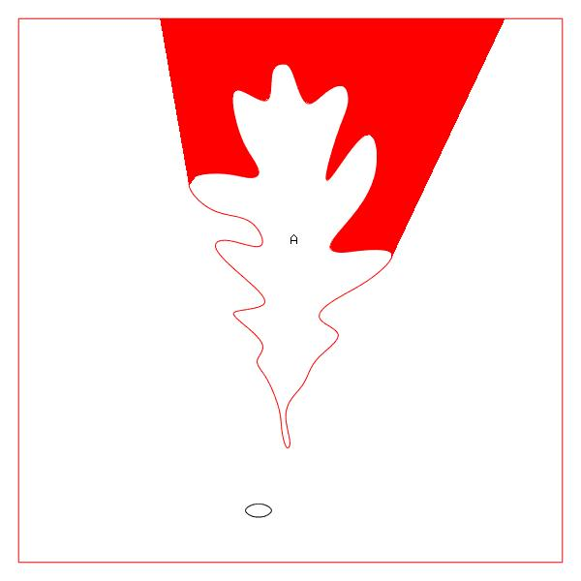
Another front and back umbra

Slide 13
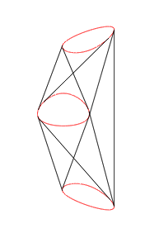
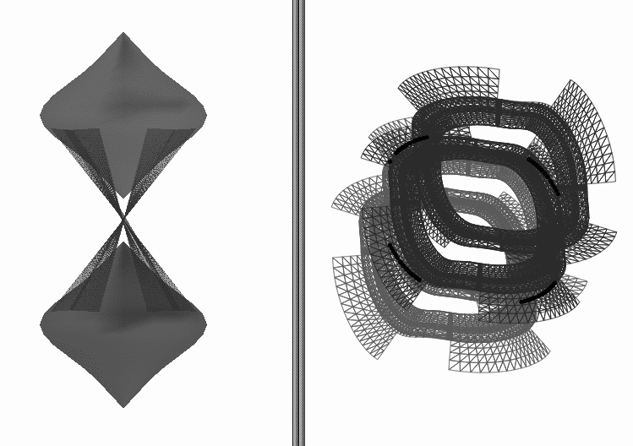
Bitangents
useful in exploring relationships between two objects
2d: bitangent (line)
3d: family of bitangent planes, yielding bitangent developable

Slide 14
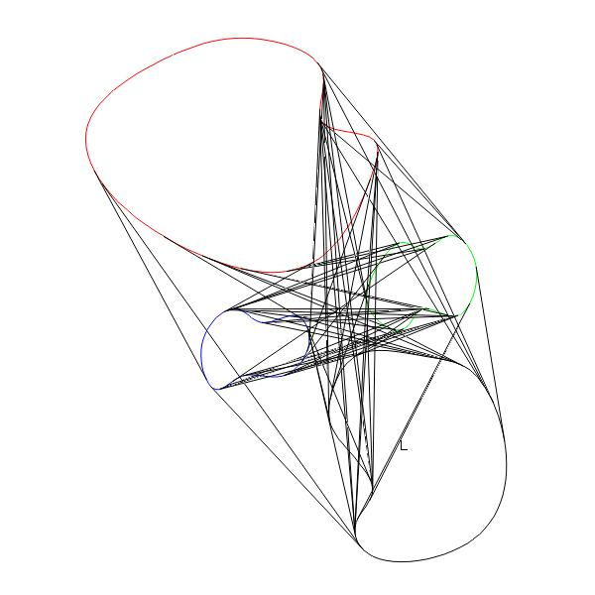
A scene has many bitangents

Slide 15
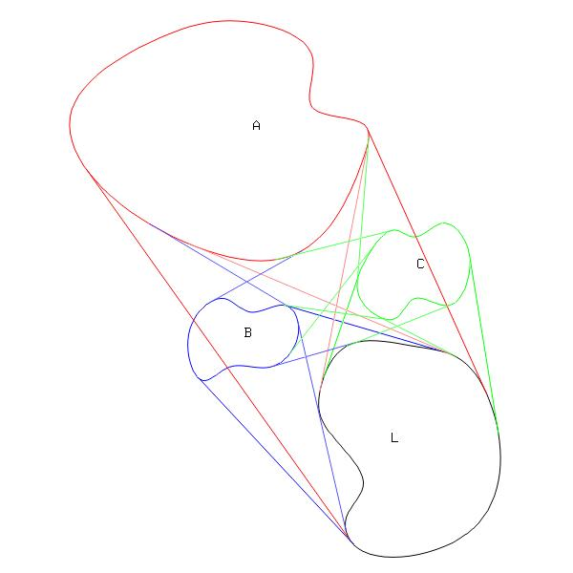
Bitangents and visual events
certain bitangents define visual events, where the qualitative nature of the visibility changes
  an object disappears or appears
  consider red bitangent of A/L on right
  green bitangent of C/L on right
  blue bitangent of A/B on left

Slide 16
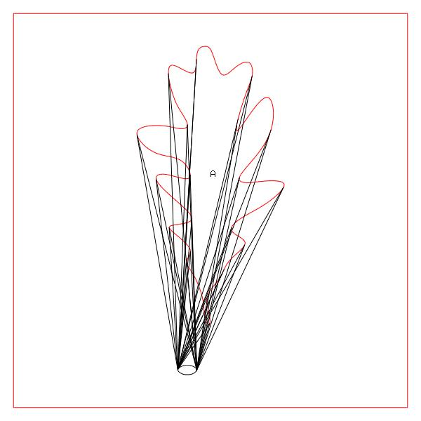
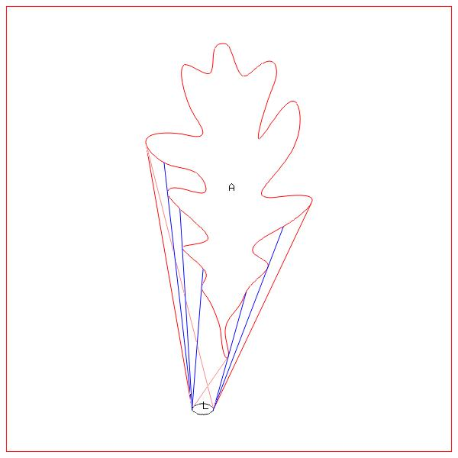
Visual events 2

Slide 17


A taxonomy of visual bitangents
outer bitangent
  defines a supporting halfplane
inner bitangent
  defines a separating halfplane
here we are drawing the ‘early’ segments of these bitangents

Slide 18
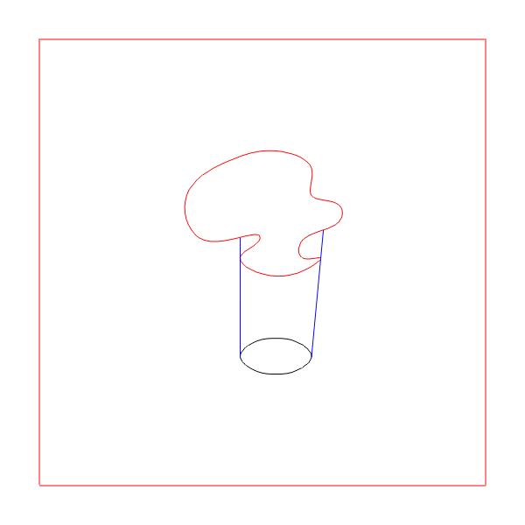
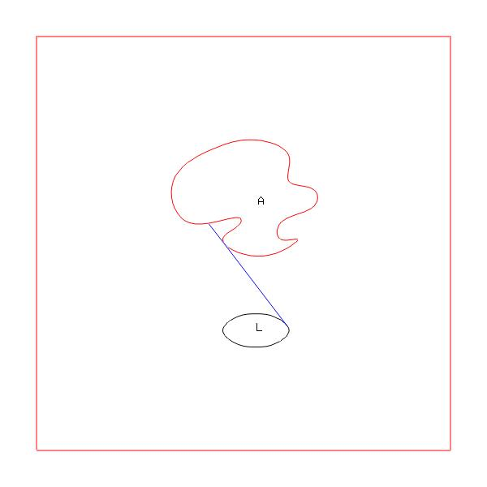
Taxonomy 2
piercing bitangent
  allow intersection with B after point of tangency
  outer piercing
  inner piercing

Slide 19
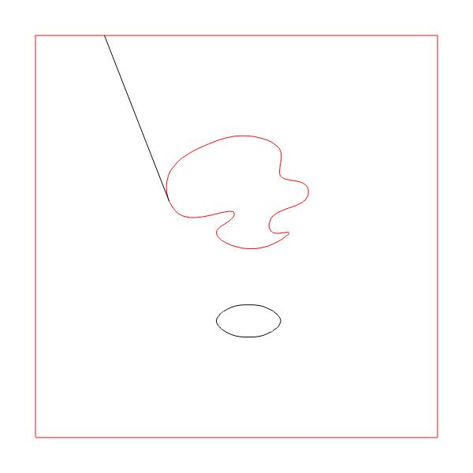

Parts of bitangents
early segment (see above)
late segment
intermediate segment

Slide 20
Local back umbra
L = distinguished object
bounded by late segments of outer bitangents with L

Slide 21
Local front umbra
bounded by intermediate segments of outer piercing bitangents

Slide 22
Filtering bitangents
visibility analysis may be interpreted as a process of filtering bitangents down to true visual events
  all bitangents → potential visual events
  potential visual events → true visual events
this second filtering is now done by sweeping

Slide 23
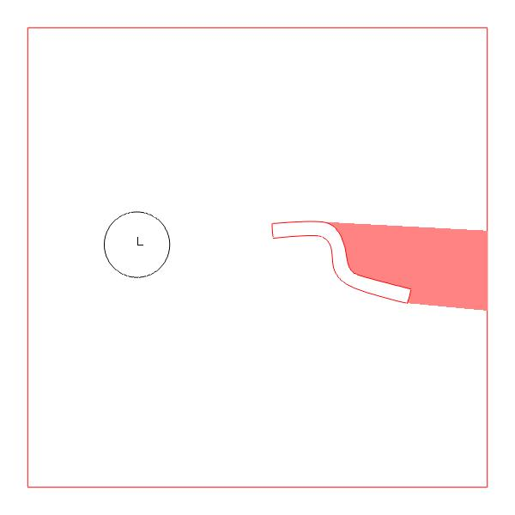
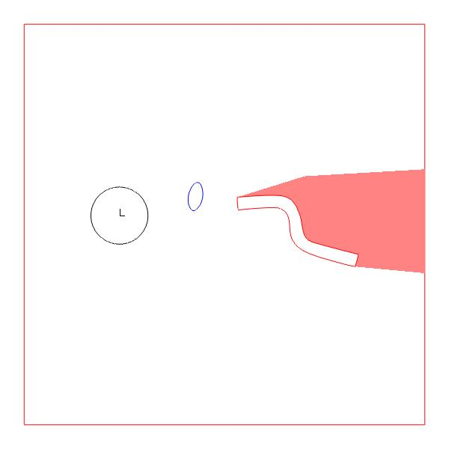
Influence of other objects
other objects may influence the umbra cast by A

Slide 24
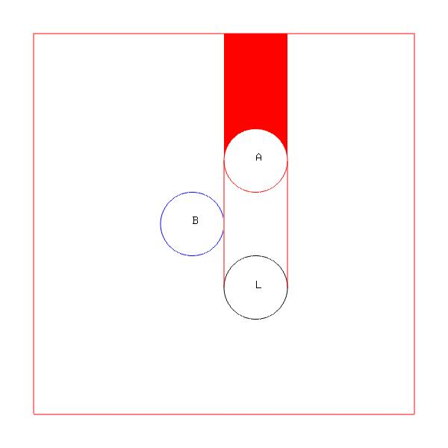
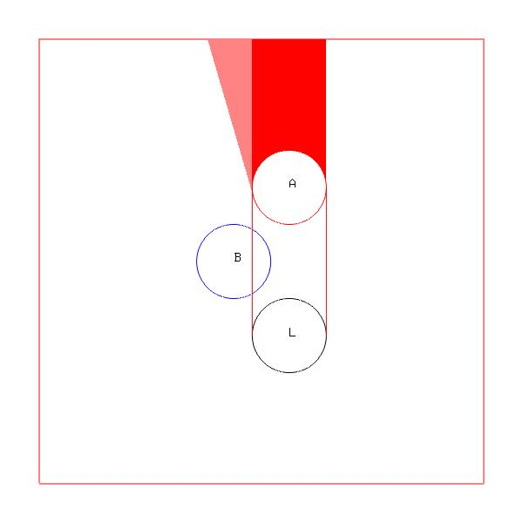
When does an object influence another object’s umbra?
when it interferes with the early segment of an outer bitangent

Slide 25
Global back umbra
need to sweep past interfering objects until L reappears
2 types of sunrise

Slide 26
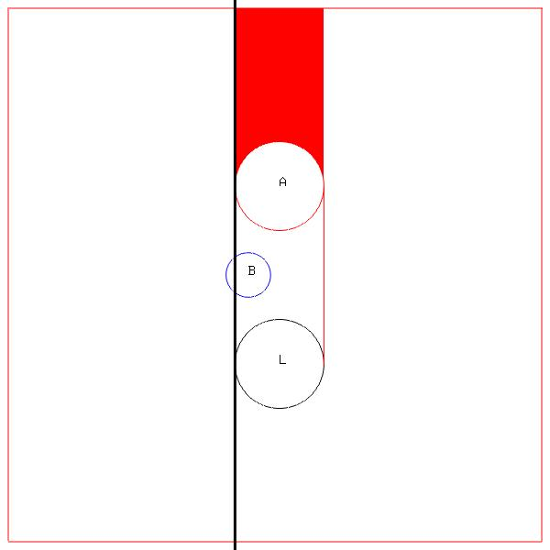
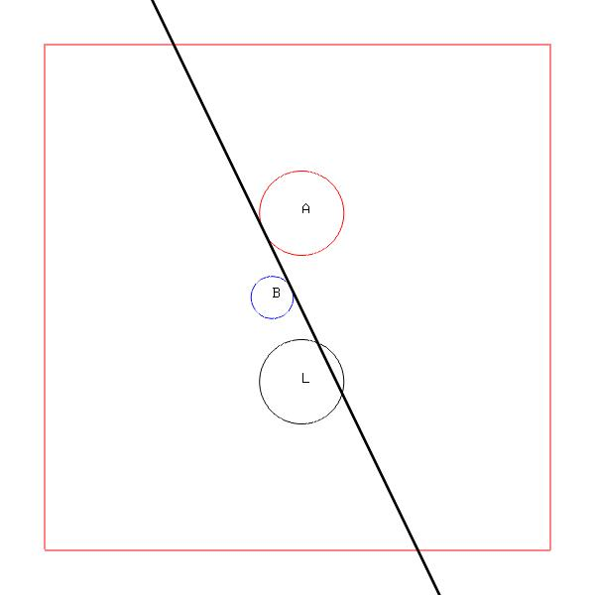
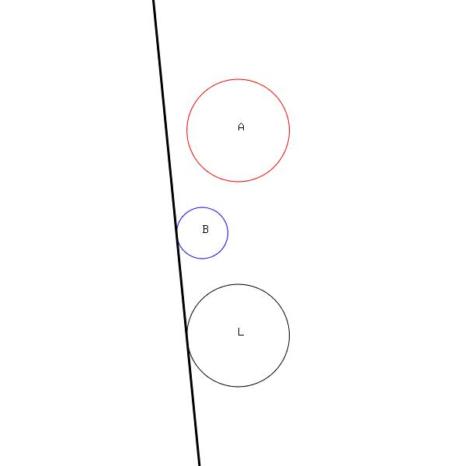
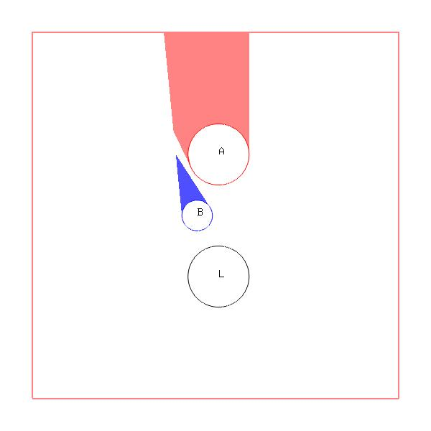
Global back umbra 2

Slide 27
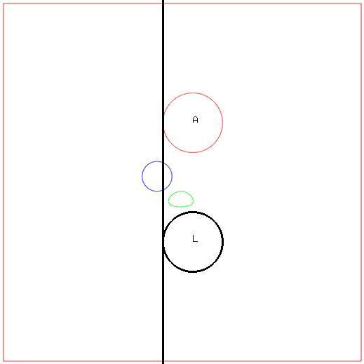
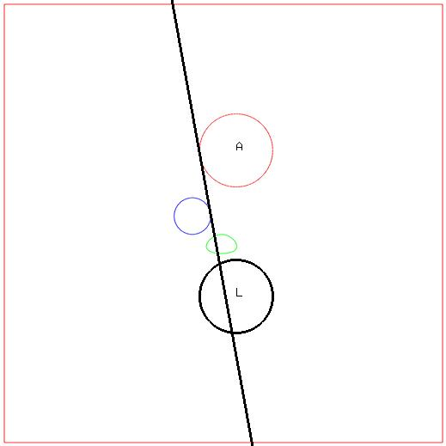
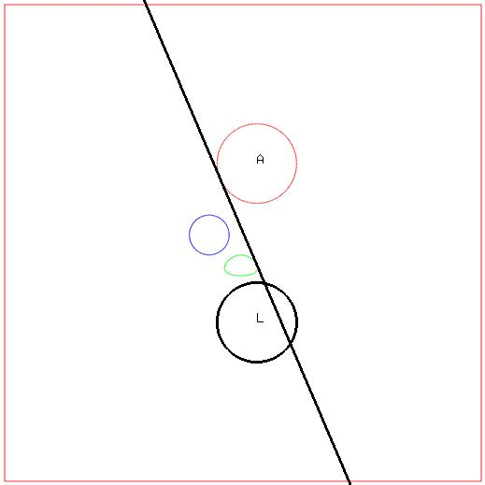

Inner sweep

Slide 28
Inner sweep algorithm
applied to each outer bitangent T of A and L
while an object B interferes with T on the segment between A and L
  T = closest inner bitangent of A and B, sweeping on A towards L
  if T has swept past L, stop

Slide 29
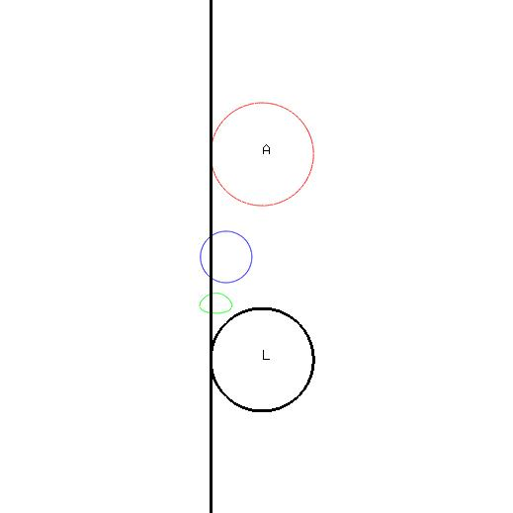
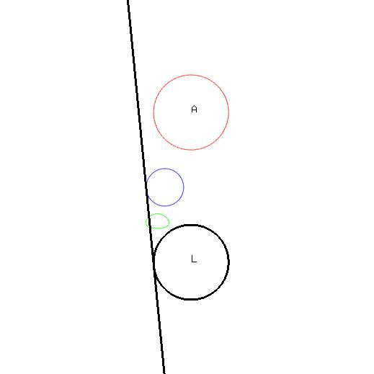
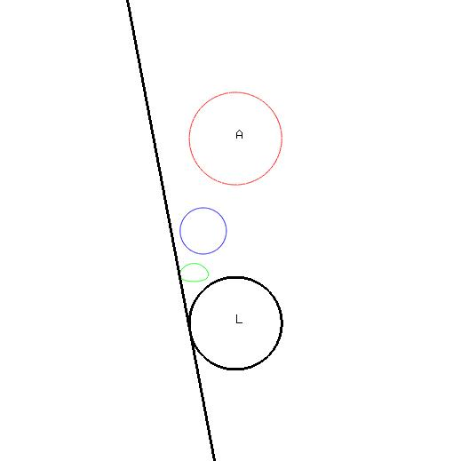
Outer sweep

Slide 30
Outer sweep algorithm
G = bitangent found by inner sweep from T
while an object B interferes with T on the segment between L and G
  T= closest outer bitangent of B and L, in sweeping on L away from A
  if T has swept past G, stop

Slide 31
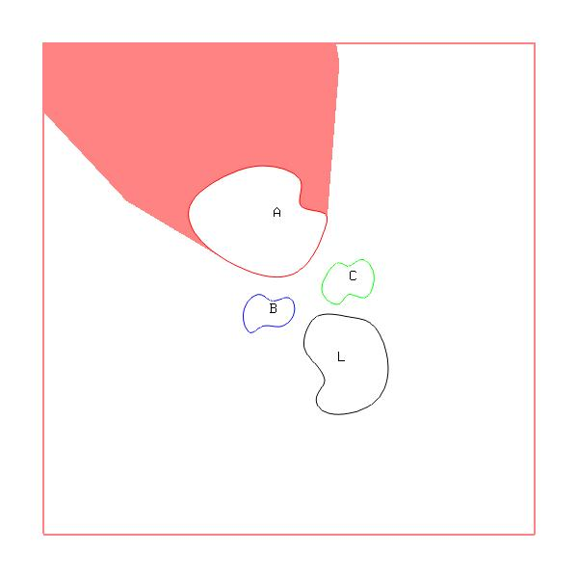
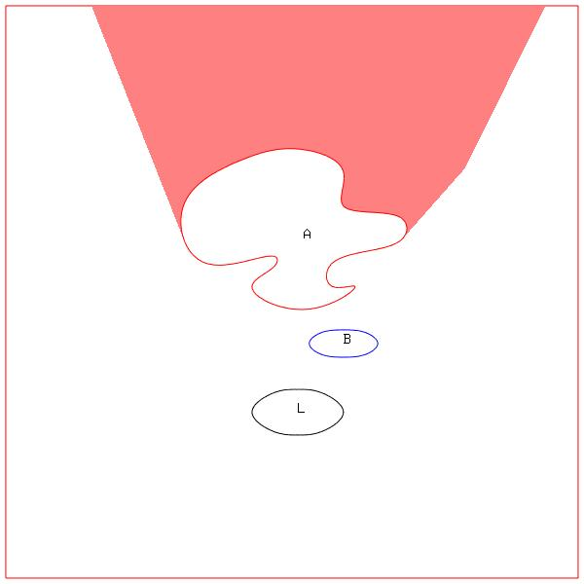
Examples of global back umbra

Slide 32
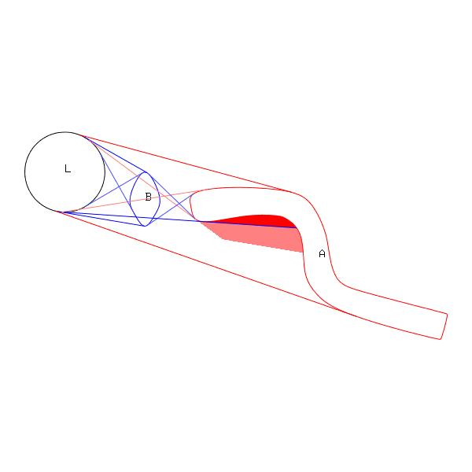
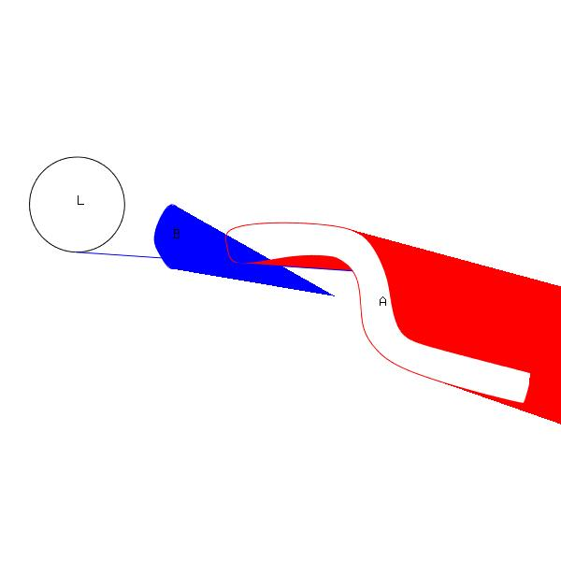
Global front umbra
B conspires with A to block more of L
  dark red: local front
  all red: global front
the local front umbra and global back umbra do not suffice

Slide 33
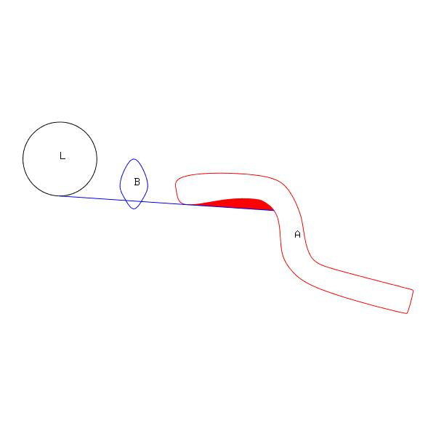
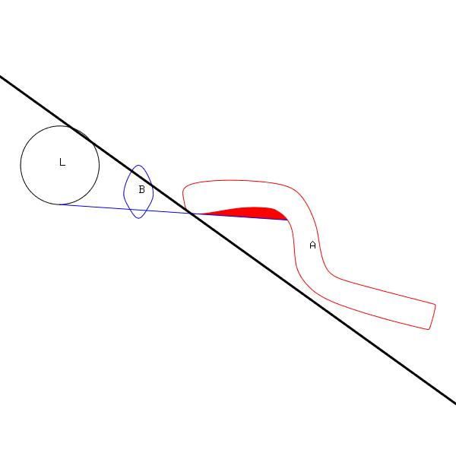
Inner piercing sweep

Slide 34
Inner piercing sweep algorithm

Slide 35
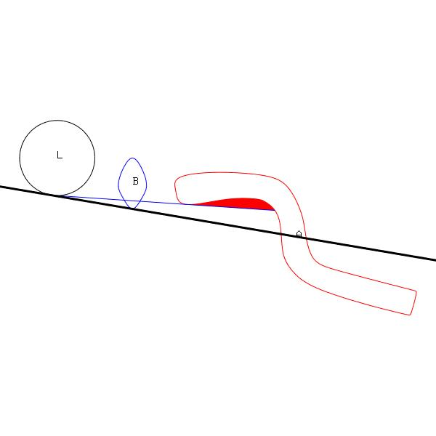
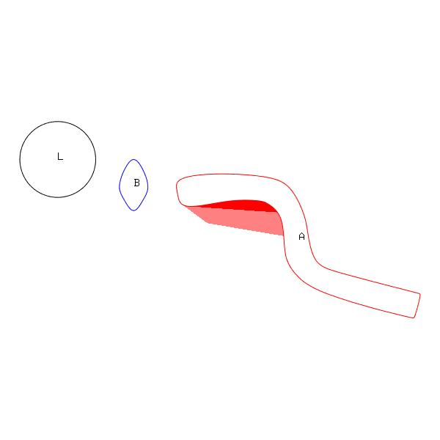
Outer piercing sweep

Slide 36
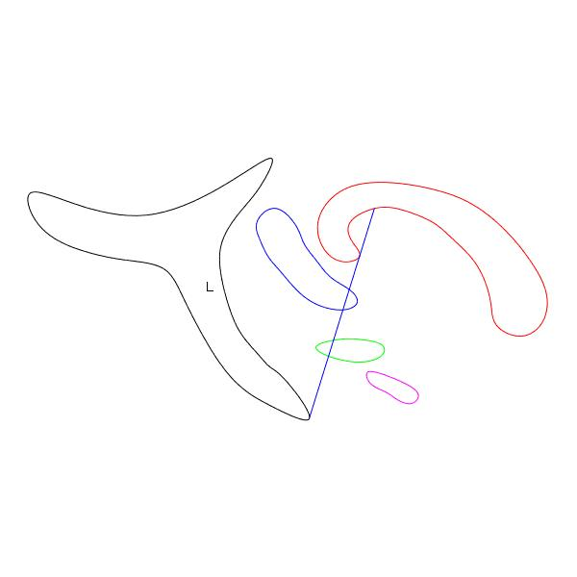
Outer piercing sweep 2
do not sweep in tangent space of A throughout
need to switch to tangent space of first interfering object
[add letter labels]

Slide 37
Outer piercing sweep algorithm

Slide 38
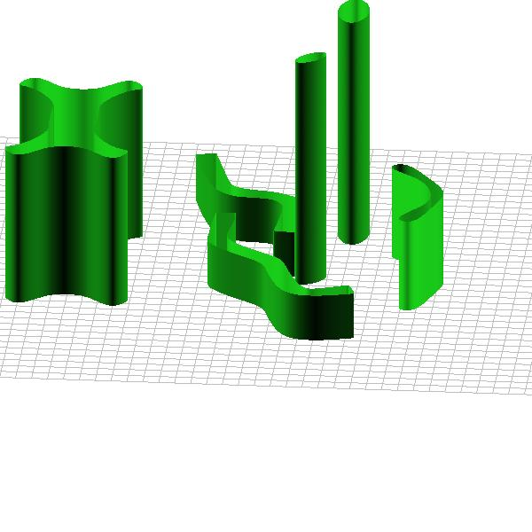
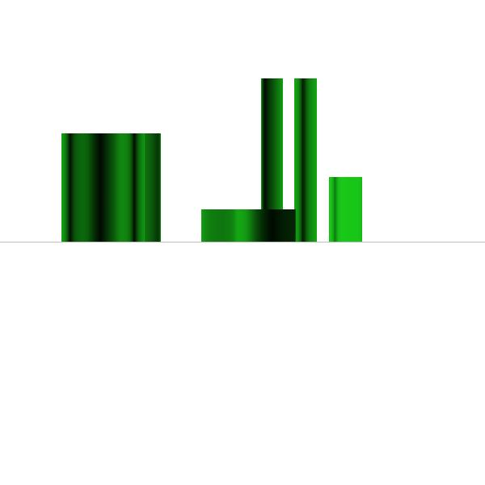
Cityscapes
a 2d solution may be used to solve 3d problems
for example, an analysis of the visibility in 2d amongst the footprints of buildings

Slide 39
Penumbra
all of this theory generalizes to penumbra

Slide 40
Bitangent developables
move to 3D
not just developables
eventually can be interpreted as the dual of a curve, but this curve can only be found by intersecting tangential surfaces in dual space

Slide 41
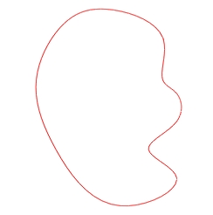
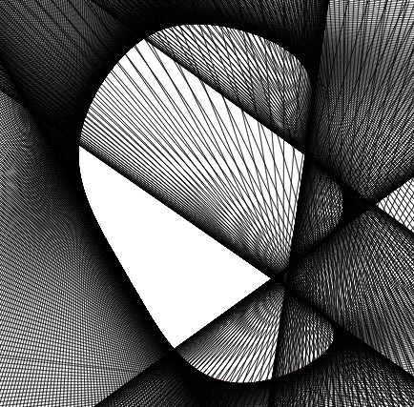
Computing bitangents
bitangents demand an understanding of tangent space

Slide 42
Duality
Duality between points and lines in 2-space
←→
line ax+by+c=0 ←→ point (a,b,c)
line kax+kby+kc=0 ←→ point (ka,kb,kc)
Notes:
Dualities between two points of view are fruitful in many disciplines. For example, in physics, the duality between matter as waves and matter as particles has led to many insights. Or, in computational geometry, the duality between vertices and faces has been used to establish a useful duality between Voronoi diagrams and Delaunay triangulations. In geometry, there is a very important duality between points and lines in 2-space. Using this duality, a set of lines in primal space will map to a set of points in dual space, and a set of points in primal space will map to a set of lines in dual space.
Many questions about lines are best referred to dual space. The computational geometry community has been particularly adept at using point-line dualities to solve problems about line arrangements such as the work of Edelsbrunner and Chazelle. This includes work on visibility graphs, such as Welzl.
There are many choices for the duality between a point and a line. We will choose the most natural one: the line ax+by+c=0 is dual to the point (a,b,c) in projective 2-space. Notice that the dual point should live in projective space since the line ax+by+c=0 is equivalent to the line kax+kby+kc=0. So we will be mapping to a projective dual space.
This choice of duality turns out to be the classical mathematical duality, for example the one encountered in Hartshorne, although interestingly not the same as any of the dualities used by the computational geometry community.
[They don’t map to projective space either: e.g. ax+by+1 -> (a,b); implicit equation must be normalized to ax+by+1.
They need dualities that satisfy special properties such as: lines sorted by angle map to points sorted by x-coordinate.]

Slide 43
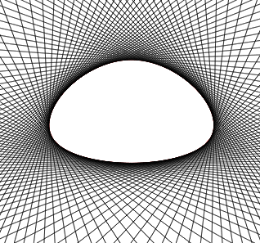
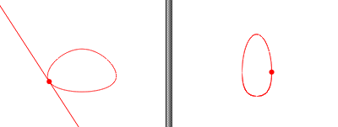
Tangential curve
Interpret tangent space as a family of lines
tangent → point
tangent space → curve
algebraic geometry
Notes:
Consider the tangent space of a curve (i.e., the 1-dimensional family of tangent lines along the curve). If we interpret the tangent space as a family of lines, it maps to a curve in dual space. After all, each tangent line maps to a point and as the tangent line sweeps smoothly about the curve, its dual point sweeps out a curve.
We call this curve in dual space, this image of the tangent space, the tangential curve. The abstract idea of dualizing a tangent space to a curve is used in algebraic geometry. The interesting part of our work insofar as the tangential curve is concerned is the implementation of this abstract idea, the working out of the details (for example, constructing the rational Bezier representation of the tangential curve), and the incorporation into an algorithm.

Slide 44
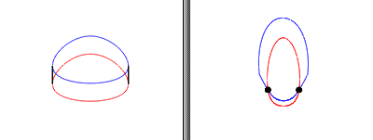
Bitangents → intersections
Compute tangential curves C* and D*.
Intersect C* and D* in dual space.
Map intersections back to bitangents.
Notes:
Our algorithm reduces to intersection of tangential curves.
In primal space, a common tangent could be interpreted as the intersection of tangent spaces.
In dual space, this becomes the intersection of tangential curves. See figure.
Suppose that we wish to compute the common tangents of C and D.
Compute the tangential curves of C and D, say C* and D*.
Intersect the tangential curves in dual space.
Then map the intersections back to primal space, where they become the common tangents.
This is a desirable reduction, since we are very comfortable with curve intersection.
We are even more comfortable with Bezier curve intersection, so we would like to compute the tangential curves as Bezier curves.

Slide 45
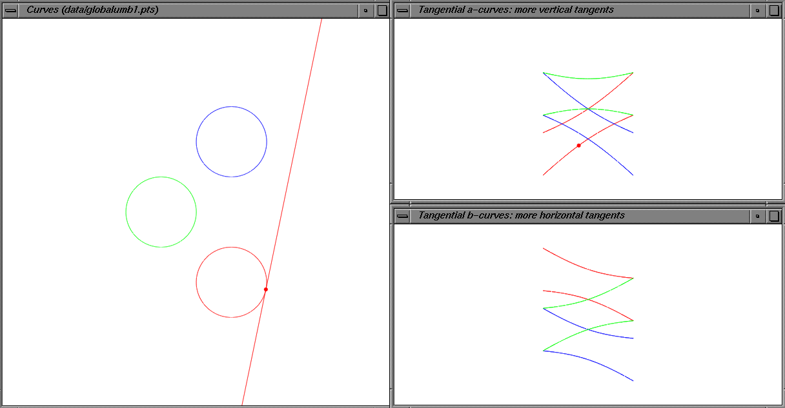
Computing bitangents
map to dual space: tangent space becomes curve
need 2 dual spaces to handle all tangents; clip to guarantee a clean cover with no overlap
bitangency becomes intersection

Slide 46
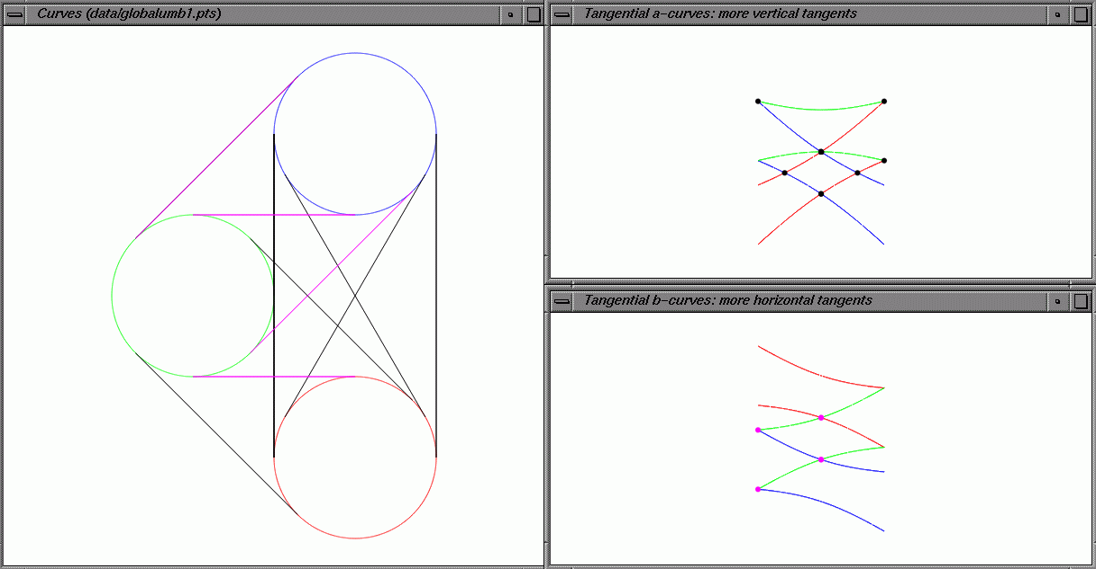

Slide 47
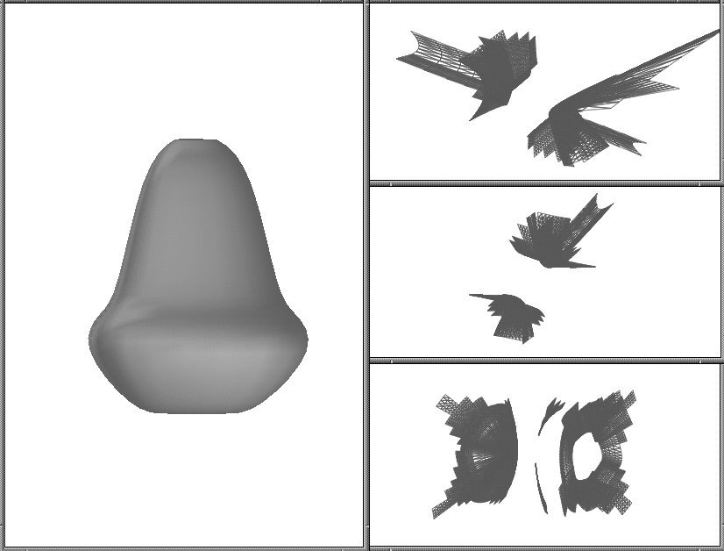
Tangential surfaces
analogous thing can be done for surfaces
3 dual spaces; Bezier structure to tangential surface
Notes:
The curve case served as an excellent template for the surface case.
Developing the theory cleanly for curves leads to a much cleaner theory for surfaces.
You get to layer the difficulty: the surface is more subtle and complicated than the curve, but shares many algorithmic approaches.
We will continue to use this strategy, for example in lighting. We believe that a full understanding of the curve case is the best preparation for the surface case.

Slide 48
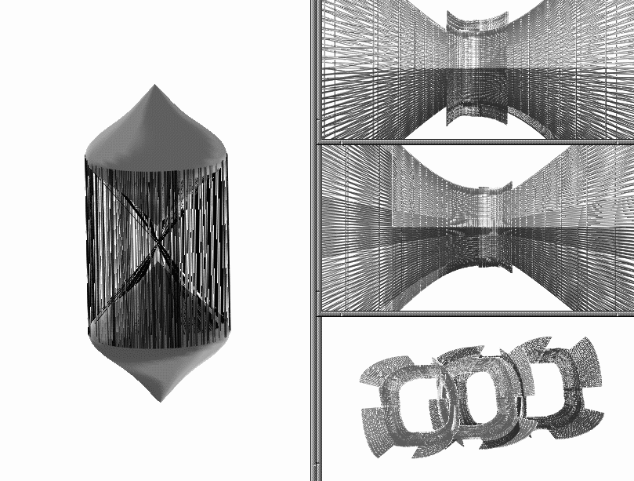
Bitangent developables

Slide 49
Robust computation
some tangent hyperplanes dualize to points at infinity
robust solution: use many cooperating dual spaces
then each dual representation must be clipped
Notes:
There is a devilish detail that we must discuss.
In mapping to dual space, some tangents will map to infinity and effectively be lost. For example, in our duality, lines ax+by=0 (lines through the origin) map to infinity. So we will miss all common tangents through the origin, and in practice all common tangents in their neighbourhood. Note that, no matter what duality we use, it is inevitable that some lines map to infinity as we map to dual space. See the paper for a proof.
How do we elegantly solve this problem? How do we robustly represent the entire tangent space?
Our solution is to use 2 dual spaces. One dual space robustly represents steep tangents (tangents with slopes more than 45 degrees) and the other dual space robustly represents the remaining shallow tangents.
[Assuming you use a duality that maps to projective space, so no normalization of lines is required.]

Slide 50
Conclusions

Slide 51
Future work
visual events and bitangents can be used to compute silhouettes of smooth objects
kernel = points that see everything
incremental analysis
parallel computation

Slide 53
Proofs
formal proof that outer bitangents bound back umbra
consider outer bitangents T1 and T2
inside T2 and behind B ➔ none of A visible on T2’s side of A
inside T1 and behind B ➔ none of A visible on T1’s side of A

Slide 54
Proofs 2
proof that outer piercing bitangents bound front umbra

Slide 55
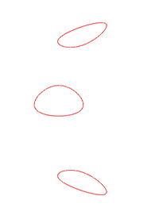
Visibility analysis
2d scene of curves
Notes:
Consider a two-dimensional scene of closed curves.
END OF THIS SLIDE.
(1) Observe that the common tangents, or bitangents, of these curves define important limits of visibility.
(2) The crossing of a common tangent by the eye often defines a visual event: that is, a qualitative change in visibility.
For example, consider crossing a common tangent at P: object C disappears over the horizon of object A. Or at Q, object D disappears over the horizon of C.
It would be important to precompute these common tangents to allow invisible objects to be culled during interactive rendering.
(3) Or if one of the curves is interpreted as an area light source and the other curves as occluders, the common tangents define the umbra and penumbra cast by this area light source.
(4) If the curves are interpreted as obstacles for a robot, the shortest paths for the robot in this environment follow the common tangents.
(5) And finally, common tangents are important for geometric operations such as convex hull.
This collection of examples, interactive rendering, lighting, robot motion and convex hull, shows that common tangents are a fundamental construct, especially crucial for visibility and motion analysis.

Slide 56
Visibility analysis
2d scene of curves
bitangents
Notes:
Last year at the Shape Modeling conference in Genoa, I talked about the computation of bitangents of smooth curves.
Today I want to continue talking about bitangents, but concentrating on their application in two core applications: lighting and convex hull.
Let’s start by looking at the various applications of bitangents.
Much of the work of geometric modeling has been on the modeling of *individual* curves and surfaces, and we know that the tangent is very important to this analysis.
But when we move to the analysis of *collections* of many curves and surfaces, the bitangent becomes important since it relates two curves or two surfaces.
In other words, the study of the interaction of objects in a scene requires the bitangent.
Naturally, there are many applications that require an understanding of the interaction of objects, such as lighting and visibility analysis and motion planning.
Observe that the common tangents, or bitangents, of these curves define important limits of visibility.

Slide 57
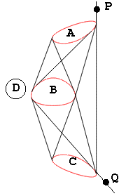
Visibility analysis
2d scene of curves
bitangents
  occlusion culling
Notes:
The crossing of a common tangent by the eye often defines a visual event: that is, a qualitative change in visibility.
For example, consider crossing a common tangent at P: object C disappears over the horizon of object A. Or at Q, object D disappears as it becomes completely blocked by C.
It would be important to precompute these common tangents to allow invisible objects to be culled during interactive rendering.

Slide 58

Visibility analysis
2d scene of curves
bitangents
  occlusion culling
  shadows
Notes:
Or if one of the curves is interpreted as an area light source and the other curves as occluders, the common tangents define the umbra and penumbra cast by this area light source.

Slide 59

Visibility analysis
2d scene of curves
bitangents
  occlusion culling
  shadows
  motion planning
Notes:
If the curves are interpreted as obstacles for a robot, the shortest paths for the robot in this environment follow the common tangents.

Slide 60

Visibility analysis
2d scene of curves
bitangents
  occlusion culling
  shadows
  motion planning
  convex hull
Notes:
And finally, common tangents are important for geometric operations such as convex hull.
This collection of examples, interactive rendering, lighting, robot motion and convex hull, shows that common tangents are a fundamental construct, especially crucial for visibility and motion analysis.
Notice that all of these operations work with smooth curves rather than polygons. We are interested in this analysis of visibility in a smooth environment.
Visibility analysis of smooth primitives certainly has a higher cost than analysis of polygonal primitives.
But it is more accurate.
Moreover, there are fewer primitives in a smooth environment, which offsets some of the cost. For example, several line segments could be replaced by a single curve segment.
Smooth visibility analysis is also the logical generalization of polygonal analysis.

Slide 62
Duality
Duality between points and lines in 2-space
←→
line ax+by+c=0 ←→ point (a,b,c)
line kax+kby+kc=0 ←→ point (ka,kb,kc)
Notes:
Dualities between two points of view are fruitful in many disciplines. For example, in physics, the duality between matter as waves and matter as particles has led to many insights. Or, in computational geometry, the duality between vertices and faces has been used to establish a useful duality between Voronoi diagrams and Delaunay triangulations. In geometry, there is a very important duality between points and lines in 2-space. Using this duality, a set of lines in primal space will map to a set of points in dual space, and a set of points in primal space will map to a set of lines in dual space.
Many questions about lines are best referred to dual space. The computational geometry community has been particularly adept at using point-line dualities to solve problems about line arrangements such as the work of Edelsbrunner and Chazelle. This includes work on visibility graphs, such as Welzl.
There are many choices for the duality between a point and a line. We will choose the most natural one: the line ax+by+c=0 is dual to the point (a,b,c) in projective 2-space. Notice that the dual point should live in projective space since the line ax+by+c=0 is equivalent to the line kax+kby+kc=0. So we will be mapping to a projective dual space.
This choice of duality turns out to be the classical mathematical duality, for example the one encountered in Hartshorne, although interestingly not the same as any of the dualities used by the computational geometry community.
[They don’t map to projective space either: e.g. ax+by+1 -> (a,b); implicit equation must be normalized to ax+by+1.
They need dualities that satisfy special properties such as: lines sorted by angle map to points sorted by x-coordinate.]

Slide 63

  has a Bezier control structure

Slide 65

Notes:
JUST TALK THROUGH THESE COMPARISON POINTS QUICKLY, NOT WITH SLIDES
hodograph:
represents tangent vector, not tangent line
Since we are working with tangent spaces, you may be wondering why we didn’t use the hodograph rather than the tangential curve. The problem is that the hodograph represents a tangent vector, not a tangent line. This subtle difference ruins them for computing common tangents, because it removes the correspondence between common tangents and intersections. So hodographs are not useful for our problem.
[For example, two different but parallel tangents could be an intersection of hodographs, and on the other hand, two equivalent tangents with different length tangent vectors will not be an intersection]
dual Bezier curve:
a curve in dual space with a primal structure is needed for a reduction to intersection
The dual Bezier curve of Hoschek is also related to the tangential curve. Why not use it? The dual Bezier curve is a representation of a curve by a set of control lines rather than control points, where the control lines encode an envelope. Thus, it is a curve in primal space represented by a dual control structure (control lines rather than control points). The tangential curve is the opposite. It is a curve in dual space represented by a traditional primal control structure. If you think about our reduction to intersection, you will see that we need a primal structure in dual space for our solution.
Plucker coordinates:
theoretically equivalent
overkill: designed for lines in 3-space
Since we are mapping lines to points, many of you may have wondered why we aren’t using Plucker coordinates of a line instead. It turns out that the algorithm can be changed to use Plucker space rather than dual space and the resulting algorithm is basically equivalent. However, since Plucker space is designed for lines in 3-space, it is more elegant and simpler to work with a 2D dual space than a 5D Plucker space. Incidentally, exactly the same problems must be solved in Plucker space, which we are about to see, such as how to manage behaviour at infinity.
tangential variety:
a practical implementation of this theoretical idea of dualizing tangent space

Slide 66

Shallow vs. steep tangents
Notes:
Here we see the steep common tangents in black and the shallow common tangents in green.
The black and green tangents will be computed in different dual spaces.
[In this figure, the primal space is on the left and the two dual spaces on the right.
Notice that the green tangents are found from green intersections and the black tangents from black intersections.]

Slide 67
The two dual spaces
Old duality: ax+by+c=0 → (a,b,c)
Duality 1: ax+by+c=0 → (c,b,a)
Duality 2: ax+by+c=0 → (a,c,b)
Duality 1 robust for steep tangents
Duality 2 robust for shallow tangents
Notes:
Here are the dualities used to define these two dual spaces. Recall that points at infinity are associated with zeros of the last coordinate in projective space. The two new dualities treat this last coordinate differently.
[Note: duality 1 is subtly different than the map used in the paper. The dual point in the paper is (b,c,a) rather than (c,b,a). Either will work but duality 1 more elegantly encodes the principles of duality.]

Slide 68

Clipping
want each tangent in exactly one dual space
tangential curves must be clipped
clipping is simple
makes segments short
Notes:
At the moment, many tangents are represented in both dual spaces.
For an elegant cooperation between the two dual spaces, each tangent must be represented in one and only one dual space.
So we have to clip the tangential curves in the top dual space so that they only represent steep tangents. We also have to clip the tangential curves in the bottom dual space so that they only represent shallow tangents. Fortunately this clipping is very simple.
The paper discusses one simple way to clip. For variety, I’ll suggest an alternative method. You can simply clip at x=1 and x=-1 in dual space. See the figure.
This makes sense: the steep tangents are robustly represented in the top dual space, so they are far from infinity, so they are close to the origin.
Notice that this clipping makes the segments very short, which speeds up intersection.
So the mapping to 2 dual spaces turns out to be an advantage!

Slide 69
Final algorithm
Notes:
We are now ready to present the final algorithm.
(1) Compute the tangential curves of C and D in each dual space, as Bezier curves.
(2) Clip the tangential curves.
(3) Intersect the clipped tangential curves in each dual space.
(4) Map both sets of intersections back to common tangents in primal space.

Slide 70

Examples
Notes:
Let’s show some more examples of the algorithm.
Here is a more complicated example.
Notice the complexity of tangential curves. This comes from two sources:
Curves with complex tangent spaces necessarily have complex tangential curves, since the tangential curve reflects the tangent space.
2. Recall that these are clipped curves. Clipping often makes it look even more jagged and complex.

Slide 71

Examples
Notes:
Yet another complicated example. Notice the common tangents at the top, which are very fragile (I.e., the tangent changes very quickly) but are still computed properly.

Slide 72
Conclusions I
Robust
  all common tangents are found
Efficient
  intersection of short Bezier curves
Simple
  intersection of Bezier curves
Excellent capacity for generalization
  surfaces
Notes:
How does our dual method perform?
It is robust. All common tangents are found: none are lost to infinity and none are lost because the curve turns too sharply.
It is efficient, since it reduces to intersection of Bezier curves, and indeed, because of clipping, intersection of short Bezier curves.
It is simple. Everyone is comfortable with intersection of Bezier curves.
The dual approach also has a better capacity to be generalized than the standard algorithm. We have already made progress on the generalization to surfaces. The generalization of the standard algorithm to surfaces is awkward and expensive.
These last 3 points are advantages over the standard algorithm.

